Slide 1
Guidelines, Principles, and Theories
Designing the User Interface:
Strategies for Effective Human-Computer Interaction
Fifth Edition
Ben Shneiderman & Catherine Plaisant
in collaboration with
Maxine S. Cohen and Steven M. Jacobs

Slide 2
Guidelines of HCI Interface
Shared language
Best practices
Critics
  Too specific, incomplete, hard to apply, and sometimes wrong
Proponents
  Encapsulate experience
2-<number>

Slide 3
Navigating the interface
Sample of the National Cancer Institutes guidelines:
  Standardize task sequences
  Ensure that embedded links are descriptive
  Use unique and descriptive headings
  Use check boxes for binary choices
  Develop pages that will print properly
  Use thumbnail images to preview larger images
2-<number>

Slide 4
Accessibility guidelines
Provide a text equivalent for every nontext element
For any time-based multimedia presentation synchronize equivalent alternatives
Information conveyed with color should also be conveyed without it
Title each frame to facilitate identification and navigation
2-<number>

Slide 5
Organizing the display
Smith and Mosier (1986) offer five high-level goals
  Consistency of data display
  Efficient information integration by the user
  Minimal memory load on the user
  Compatibility of data display with data entry
  Flexibility for user control of data display
2-<number>

Slide 6
Getting the user’s attention
Intensity
Marking
Size
Choice of fonts
Inverse video
Blinking
Color
Audio
2-<number>

Slide 7
Principles
More fundamental, widely applicable, and enduring the guidelines
Need more clarification
Fundamental principles
  Determine user’s skill levels
  Identify the tasks
Five primary interaction styles
Eight golden rules of interface design
Prevent errors
Automation and human control
2-<number>

Slide 8
Determine user’s skill levels
“Know thy user”
Age, gender, physical and cognitive abilities, education, cultural or ethnic background, training, motivation, goals and personality
Design goals based on skill level
  Novice or first-time users
  Knowledgeable intermittent users
  Expert frequent users
Multi-layer designs
2-<number>

Slide 9
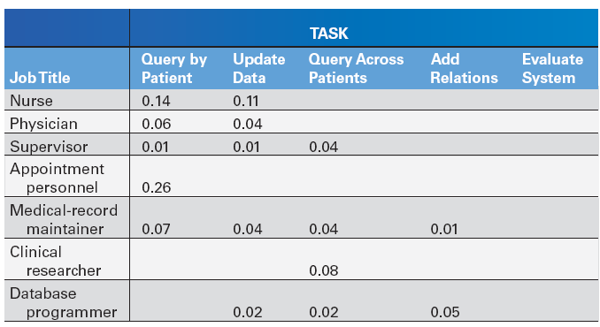
Identify the tasks
Task Analysis usually involve long hours observing and interviewing users
Decomposition of high level tasks
Relative task frequencies
2-<number>

Slide 10
Choose an interaction style
Direct Manipulation
Menu selection
Form filling
Command language
Natural language
2-<number>

Slide 11
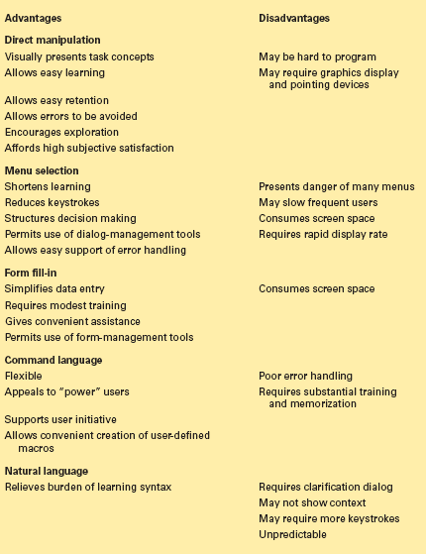
2-<number>

Slide 12
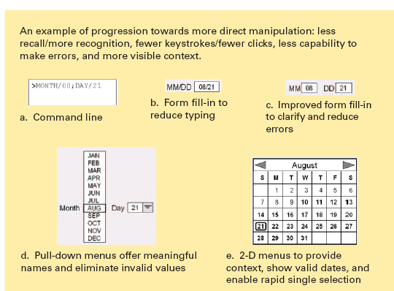
Spectrum of Directness
2-<number>

Slide 13
The 8 golden rules of interface design
Strive for consistency
Cater to universal usability
Offer informative feedback
Design dialogs to yield closure
Prevent errors
Permit easy reversal of actions
Support internal locus of control
Reduce short term memory load
2-<number>
Notes:
Design dialogs to yield closure. Sequences of actions should be organized into
groups with a beginning, middle, and end. Informative feedback at the completion
of a group of actions gives operators the satisfaction of accomplishment,
a sense of relief, the signal to drop contingency plans from their
minds, and a signal to prepare for the next group of actions. For example,
e-commerce web sites move users from selecting products to the checkout,
ending with a clear confirmation page that completes the transaction.
Support internal locus of control. Experienced operators strongly desire the
sense that they are in charge of the interface and that the interface responds
to their actions. Surprising interface actions, tedious sequences of data
entries, inability to obtain or difficulty in obtaining necessary information,
and inability to produce the action desired all build anxiety and dissatisfaction.
Reduce short term memory load:
The limitation of human information processing
in short-term memory (the rule of thumb is that humans can remember
"seven plus or minus two chunks" of information) requires that displays be
kept simple, multiple-page displays be consolidated, window-motion frequency
be reduced, and sufficient training time be allotted for codes,
mnemonics, and sequences of actions.

Slide 14
Prevent errors
Make error messages specific, positive in tone, and constructive
Mistakes and slips (Norman, 1983)
Correct actions
  Gray out inappropriate actions
  Selection rather than freestyle typing
  Automatic completion
Complete sequences
  Single abstract commands
  Macros and subroutines
2-<number>

Slide 15
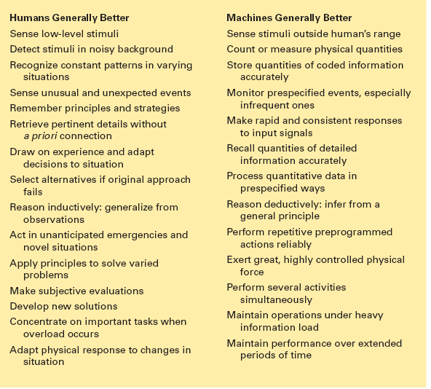
Automation and human control
2-<number>

Slide 16
Automation and human control (cont.)
Successful integration:
  Users can avoid:
    Routine, tedious, and error prone tasks
  Users can concentrate on:
    Making critical decisions, coping with unexpected situations, and planning future actions
2-<number>

Slide 17
Automation and human control (cont.)
Supervisory control needed to deal with real world open systems
  E.g. air-traffic controllers with low frequency, but high consequences of failure
  FAA: design should place the user in control and automate only to improve system performance, without reducing human involvement
2-<number>

Slide 18
Automation and human control (cont.)
Goals for autonomous agents
  knows user's likes and dislikes
  makes proper inferences
  responds to novel situations
  performs competently with little guidance
Tool like interfaces versus autonomous agents
Aviators representing human users, not computers, more successful
2-<number>

Slide 19
Automation and human control (cont.)
User modeling for adaptive interfaces
  keeps track of user performance
  adapts behavior to suit user's needs
  allows for automatically adapting system
    response time, length of messages, density of feedback, content of menus, order of menu items, type of feedback, content of help screens
  can be problematic
    system may make surprising changes
    user must pause to see what has happened
    user may not be able to
      predict next change
      interpret what has happened
      restore system to previous state
2-<number>

Slide 20
Automation and human control (cont.)
Alternative to agents:
  user control, responsibility, accomplishment
  expand use of control panels
    style sheets for word processors
    specification boxes of query facilities
    information-visualization tools
2-<number>

Slide 21
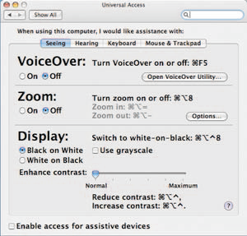
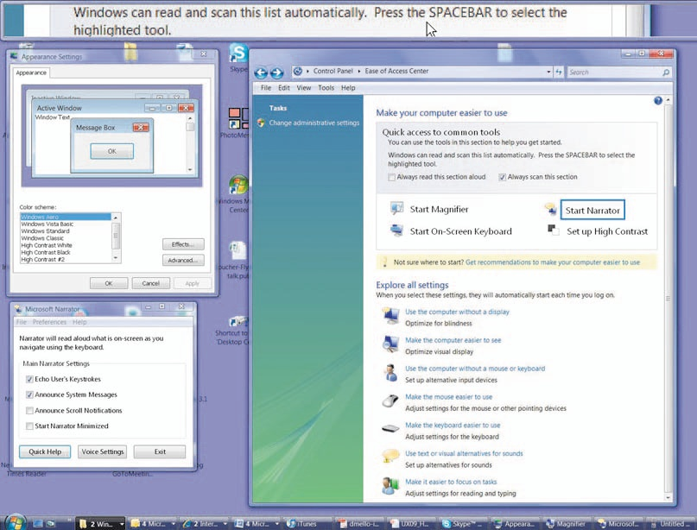
Automation and human control (concluded)
Features to aid in universal access
Above: Mac OS X system preference settings
Right: Windows Vista Control Panel
2-<number>

Slide 22
Theories
  Beyond the specifics of guidelines
  Principles are used to develop theories
  Descriptions/explanatory or predictive
  Motor task, perceptual, or cognitive
2-<number>

Slide 23
Explanatory and predictive theories
Explanatory theories:
  Observing behavior
  Describing activity
  Conceiving of designs
  Comparing high-level concepts of two designs
  Training
Predictive theories:
  Enable designers to compare proposed designs for execution time or error rates
2-<number>

Slide 24
Perceptual, Cognitive, & Motor tasks
Perceptual or Cognitive subtasks theories
  Predicting reading times for free text, lists, or formatted displays
Motor-task performance times theories:
  Predicting keystroking or pointing times
2-<number>

Slide 25
Taxonomy (explanatory theory)
  Order on a complex set of phenomena
  Facilitate useful comparisons
  Organize a topic for newcomers
  Guide designers
  Indicate opportunities for novel products.
2-<number>

Slide 26
Conceptual, semantic, syntactic, and lexical model
Foley and van Dam four-level approach
  Conceptual level:
    User's mental model of the interactive system
  Semantic level:
    Describes the meanings conveyed by the user's command input and by the computer's output display
  Syntactic level:
    Defines how the units (words) that convey semantics are assembled into a complete sentence that instructs the computer to perform a certain task
  Lexical level:
    Deals with device dependencies and with the precise mechanisms by which a user specifies the syntax
Approach is convenient for designers
  Top-down nature is easy to explain
  Matches the software architecture
  Allows for useful modularity during design
2-<number>
Notes:
Two mental models for image creation are paint programs that manipulate
pixels and drawing programs that operate on objects. Users of paint programs
think in terms of sequences of actions on pixels and groups of pixels,
while users of drawing programs apply operators to alter and group objects.
Decisions about mental models affect each of the lower levels.
2. The semantic level describes the meanings conveyed by the user's input
and by the computer's output display. For example, deleting an object in a
drawing program could be accomplished by undoing a recent action or by
invoking a delete-object action. Either action should eliminate a single object
and leave the rest untouched.
3. The syntactic level defines how the user actions that convey semantics are
assembled into complete sentences that instruct the computer to perform certain
tasks. For example, the delete-files action could be invoked by a multipleobject
selection, followed by a keystroke, followed by a confirmation.
4. The lexical level deals \vith device dependencies and with the precise mechanisms
by which users specify the syntax (for example, a function key or a
mouse double-click within 200 milliseconds).

Slide 27
Stages of action models
Norman's seven stages of action
  Forming the goal
  Forming the intention
  Specifying the action
  Executing the action
  Perceiving the system state
  Interpreting the system state
  Evaluating the outcome
Norman's contributions
  Context of cycles of action and evaluation.
  Gulf of execution: Mismatch between the user's intentions and the allowable actions
  Gulf of evaluation: Mismatch between the system's representation and the users' expectations
2-<number>

Slide 28
Stages of action models (cont.)
Four principles of good design
  State and the action alternatives should be visible
  Should be a good conceptual model with a consistent system image
  Interface should include good mappings that reveal the relationships between stages
  User should receive continuous feedback
Four critical points where user failures can occur
  Users can form an inadequate goal
  Might not find the correct interface object because of an incomprehensible label or icon
  May not know how to specify or execute a desired action
  May receive inappropriate or misleading feedback
2-<number>

Slide 29
Consistency through grammar
Consistent user interface goal
  Definition is elusive - multiple levels sometimes in conflict
  Sometimes advantageous to be inconsistent.
Consistent Inconsistent A Inconsistent B
delete/insert character delete/insert character delete/insert character
delete/insert word remove/bring word remove/insert word
delete/insert line destroy/create line delete/insert line
delete/insert paragraph kill/birth paragraph delete/insert paragraph
2-<number>

Slide 30
Consistency through grammar (cont.)
Inconsistent action verbs
  Take longer to learn
  Cause more errors
  Slow down users
  Harder for users to remember
2-<number>

Slide 31
The disappearance of syntax
Users must maintain a excess of device-dependent details in their human memory.
  Which action erases a character
  Which action inserts a new line after the third line of a text file
  Which abbreviations are permissible
  Which of the numbered function keys produces the previous screen.
2-<number>

Slide 32
The disappearance of syntax (cont.)
Learning, use, and retention of this knowledge is hampered by two problems
  Details vary across systems in an unpredictable manner
  Greatly reduces the effectiveness of paired-associate learning
Syntactic knowledge conveyed by example and repeated usage
Syntactic knowledge is system dependent
2-<number>

Slide 33
The disappearance of syntax (concluded)
Minimizing these burdens is the goal of most interface designers
  Modern direct-manipulation systems
  Familiar objects and actions representing their task objects and actions.
  Modern user interface building tools
  Standard widgets
2-<number>

Slide 34
Contextual Theories
User actions are situated by time and place
  You may not have time to deal with shortcuts or device dependent syntax, such as on mobile devices, when hurried
  Physical space is important in ubiquitous, pervasive and embedded devices, e.g. a museum guide stating information about a nearby painting
A taxonomy for mobile device application development could include:
  Monitor and provide alerts, e.g. patient monitoring systems
  Gather information
  Participate in group collaboration
  Locate and identify nearby object or site
  Capture information about the object and share that information
2-<number>

